Slide 1

Movie ReVIEW ANALYSIS
MID REVIEW TEAM 5

Slide 2
TEAM 5 P L NARASIMHA-S20210010185 K SIVA SAI-S20210010102

Slide 3
OVERVIEW
IMPORTING DATASET
Handling Missing Values NA
Adding Data through Web Scrapping
Expand Contractions(Text Normalization)
Expanding the Abbreviations
LOWERCASING OF TEXT
REMOVING SPECIAL CHARACTERS AND NUMBERS USING RE
REMOVING STOPWORDS
REMOVING NULL CONTENTS
Spell Checking
LEMMITIZATION OF TEXT
Adding Features Using POSTagging
Dividing the Columns in Dataset

Slide 4
Data Collection
Main Dataset collected from Kaggle
Added some of our own Data
By Web Scraping

Slide 5
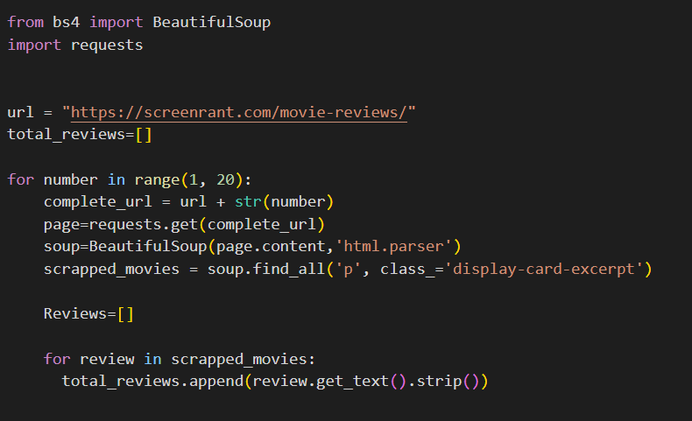
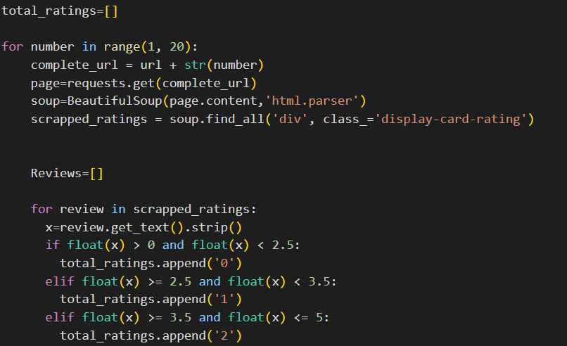
Web Scraping
Through Web Scraping we collected some data

Slide 6
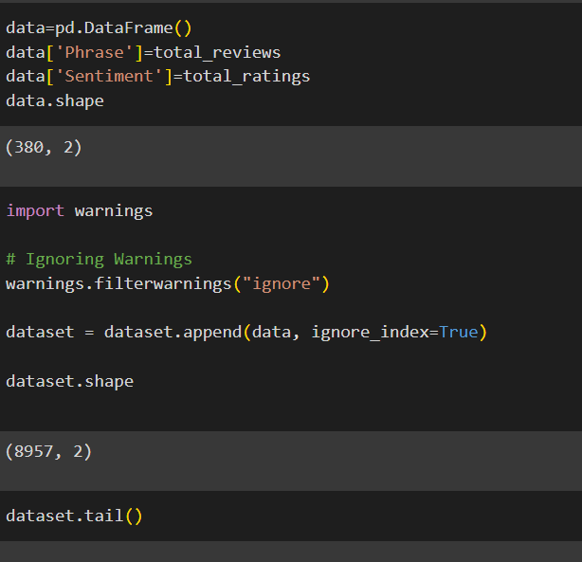
Merging the data
After collecting data from Web Scraping we need to merge the data with our csv file

Slide 7
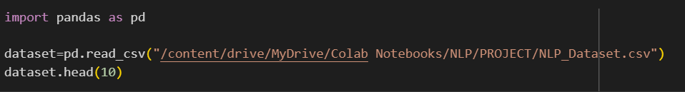
DATASET IMPLEMENTATION
First we have taken a Dataset from known resources
And we have 50 extra samples to it and extracted to the project using google mount
Now we have imported pandas library and read the dataset through it

Slide 8
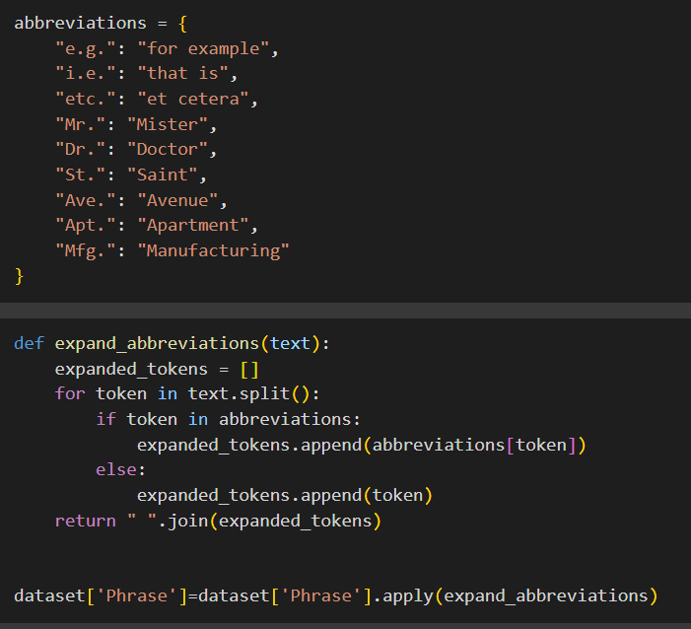
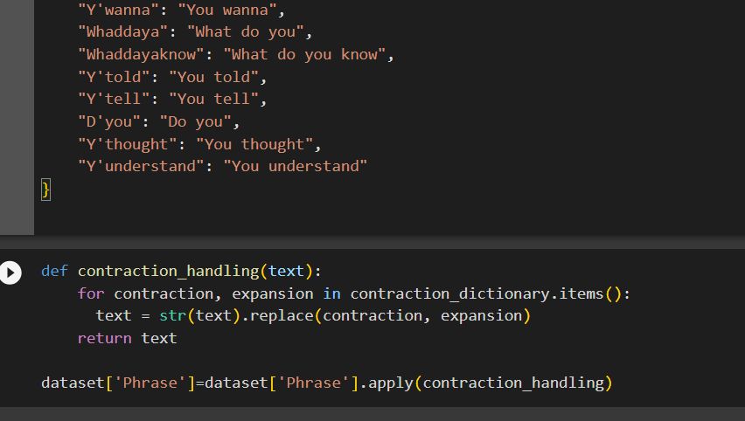
TEXT NORMALISATION
Normalisation of text ,converts the contractions ,abbreviation forms into expanded forms

Slide 9
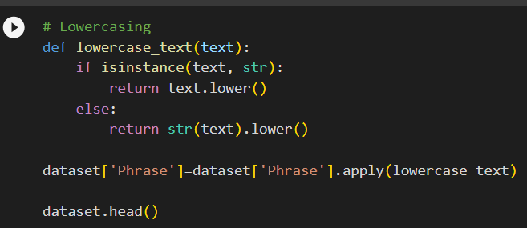
LOWER CASING
In Lower casing it converts all sentences into lower cases

Slide 10
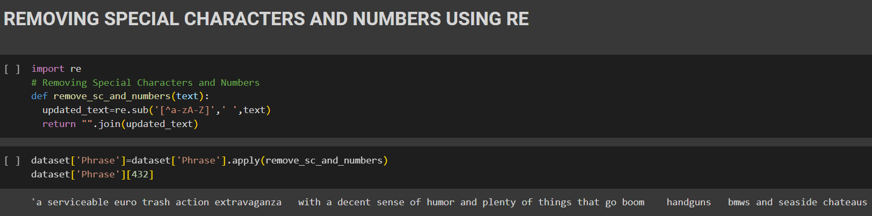
REMOVING SPECIAL CHARCATERS USING RE
By using the regular expressions we remove special characters like ,- and any numbers having in it

Slide 11
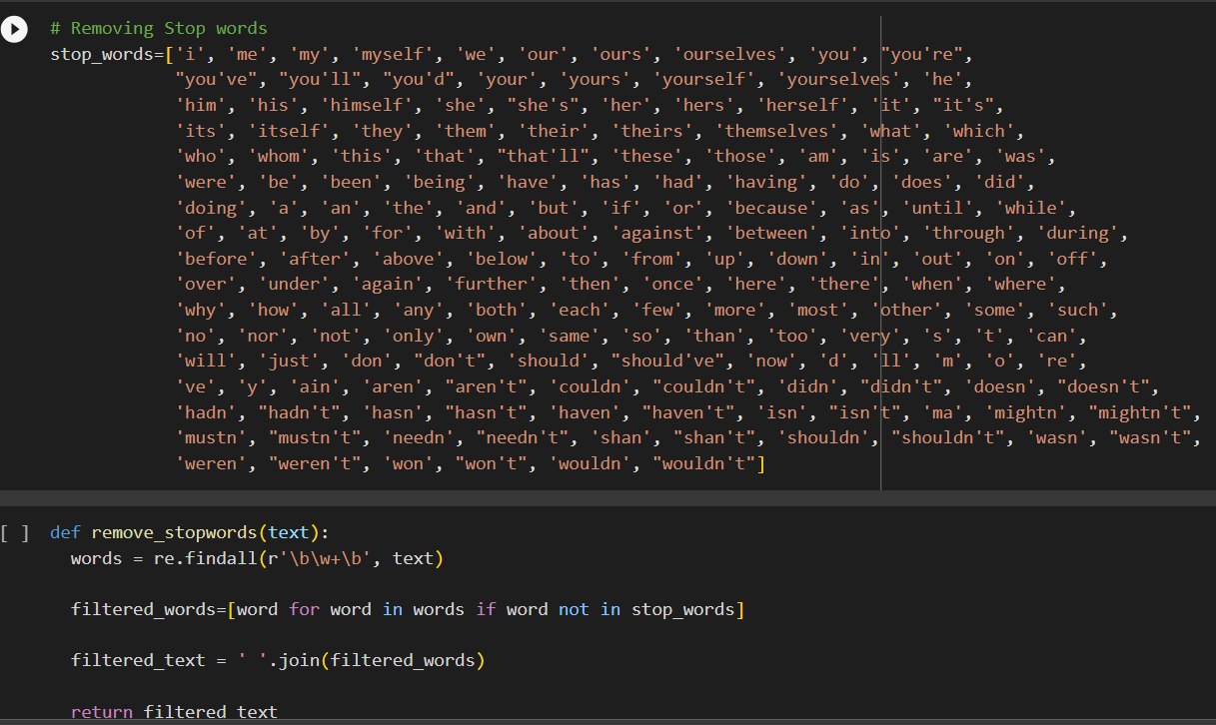
REMOVING STOP WORDS
By Taking a Stopwords list it check whether it contains the stopwords and removes it

Slide 12
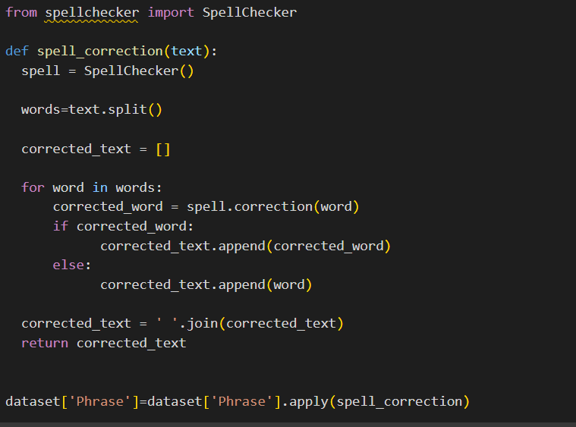
SPELL CHECKER
Spell Checker checks and converts the word if there is any mistakes in it

Slide 13
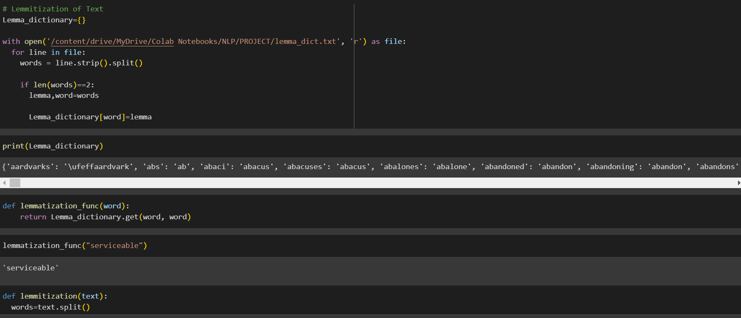
LEMMETIZATION
It coverts the words into its lemma i.e base words

Slide 14
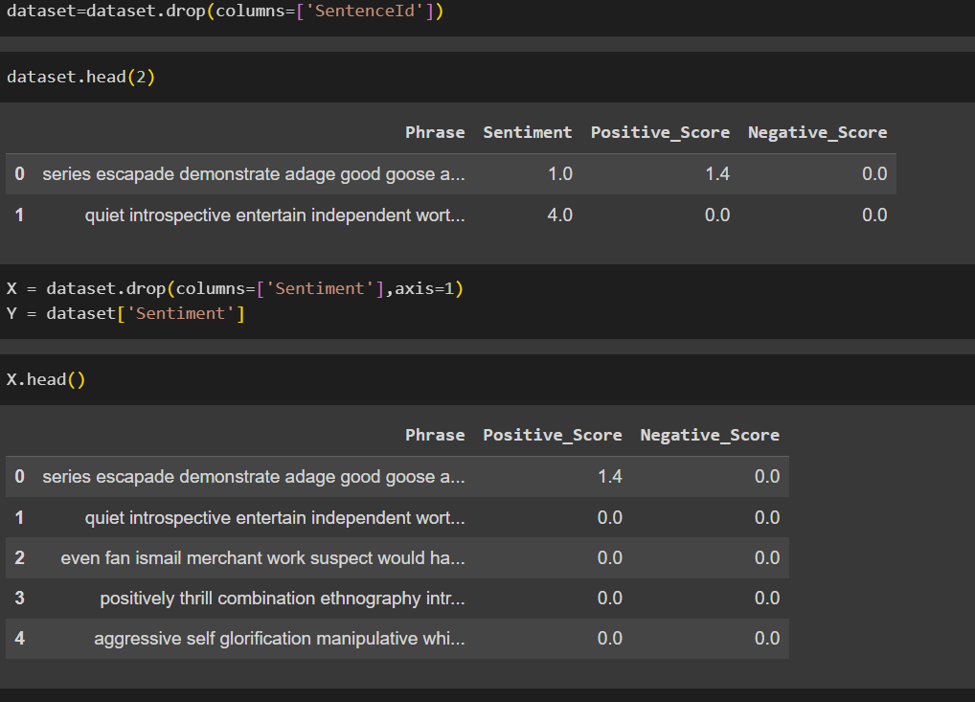
DIVIDING COLUMS IN DATASET
Divide the sentiment column from the dataset to use it for model

Slide 15
After Mid
POStagging
Keyword extraction
Bag of words
Name Entity Recognition(NER)
TF-IDF Vectorization
Word Embeddings
Model Building

Slide 16
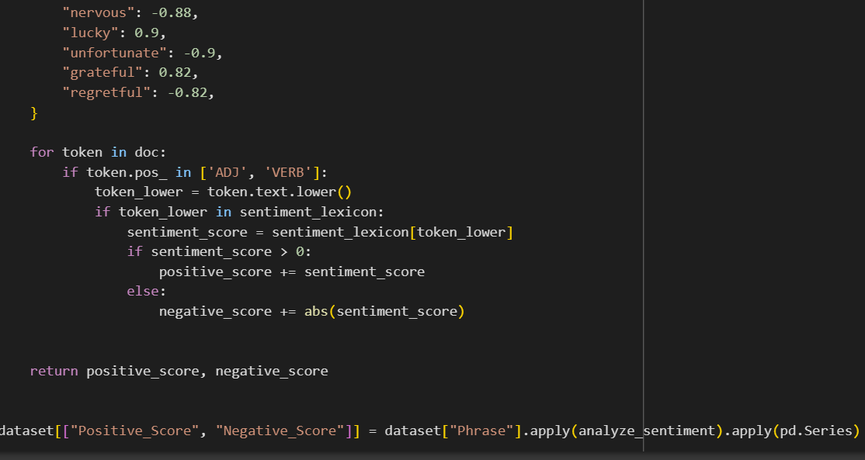
POSTagging
Adding positive score and negative score for the phrases and adding two new columns to the dataset

Slide 17
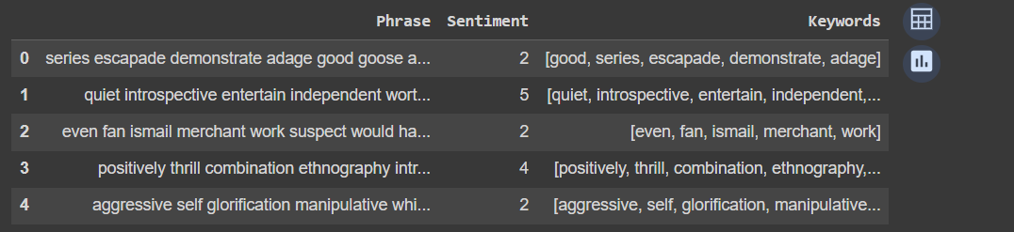
Keyword Extraction
Here we will find out the key words and use it for postagging

Slide 18
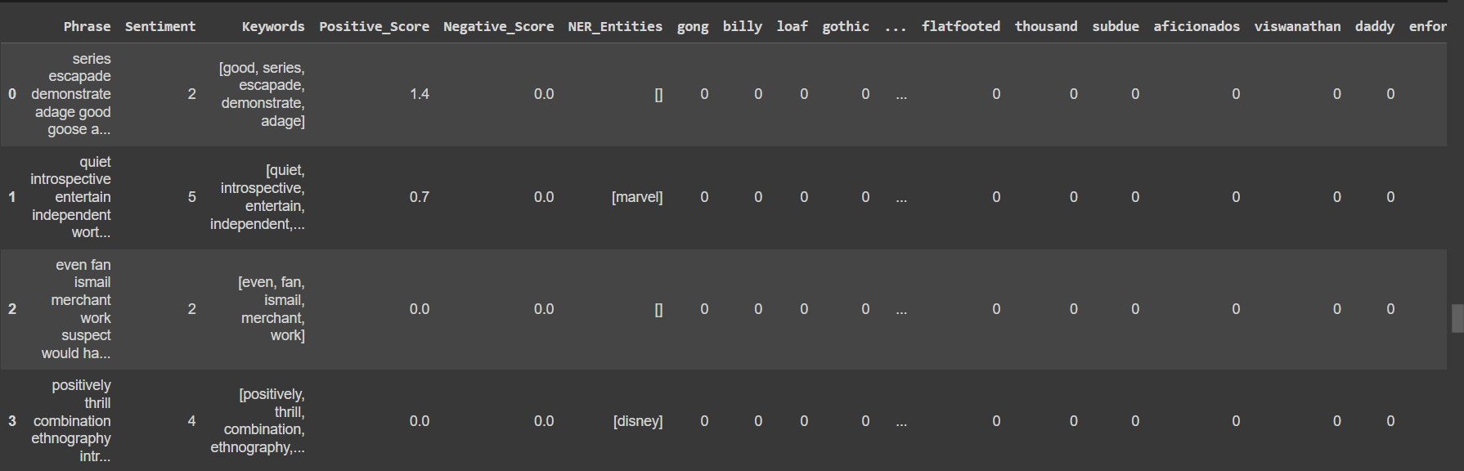
Bag Of Words
Here using of bag of words will help us in review analysis to determine the sentiment
It helps in capturing the prevelance of sentiment-bearing words

Slide 19
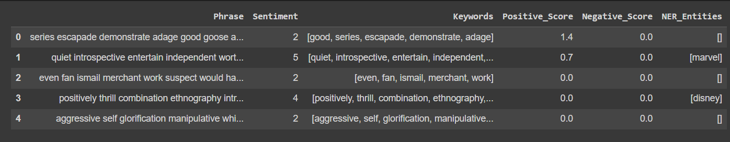
NER
NER helps in identifying the entities which will be useful to identify entities associated with sentiment-bearing expressions.
Provides content or understanding the sentiment expressed in text

Slide 20
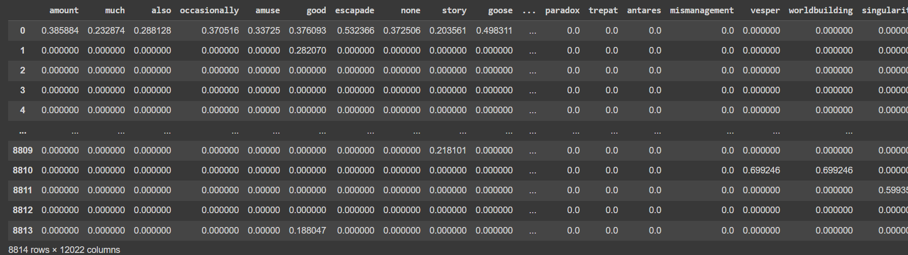
TF-IDF Vectorization
Here we calculate the TF-IDF

Slide 21
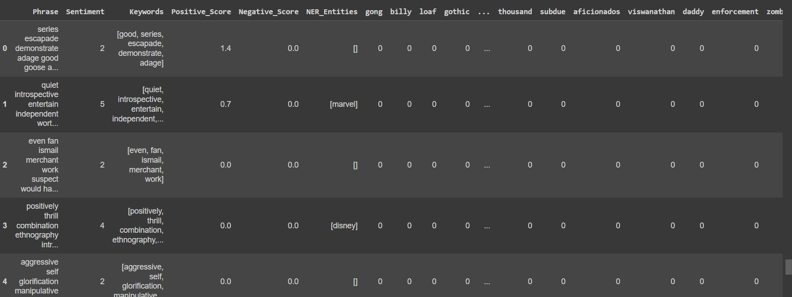
Word Embeddings
Word Embeddings contributes to the effectiveness of sentimental classifiesr and models

Slide 22
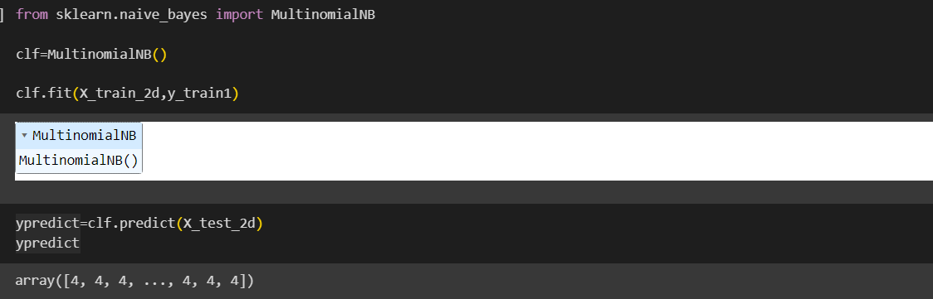
Model Building

